Slide 1
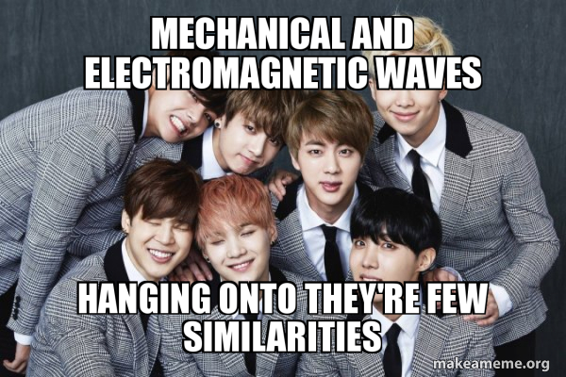
Properties of waves day 3
10/18 & 10/20
THEIR
Standard 8.PS4.2

Slide 2
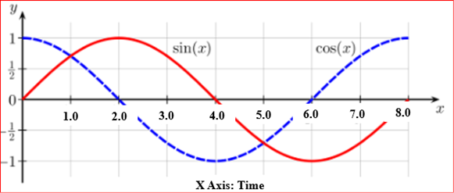
DQ
Examine the sine and cosine wave patterns in the following graph.
(Multi-Select Question) Select three choices below that accurately describe this graph.
A. Both waves are electromagnet waves.
B. Both waves have the same wavelength.
C. Both waves are being transmitted through a liquid
D. Both waves have the same frequency.
E. Both waves have the same amplitude.
Standard 8.PS4.2

Slide 3
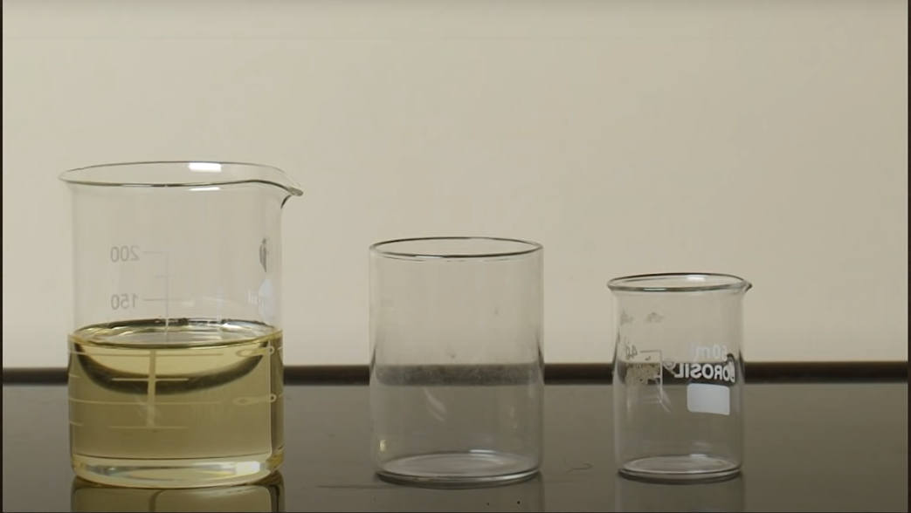
Observe the beakers
Standard 8.PS4.2

Slide 4
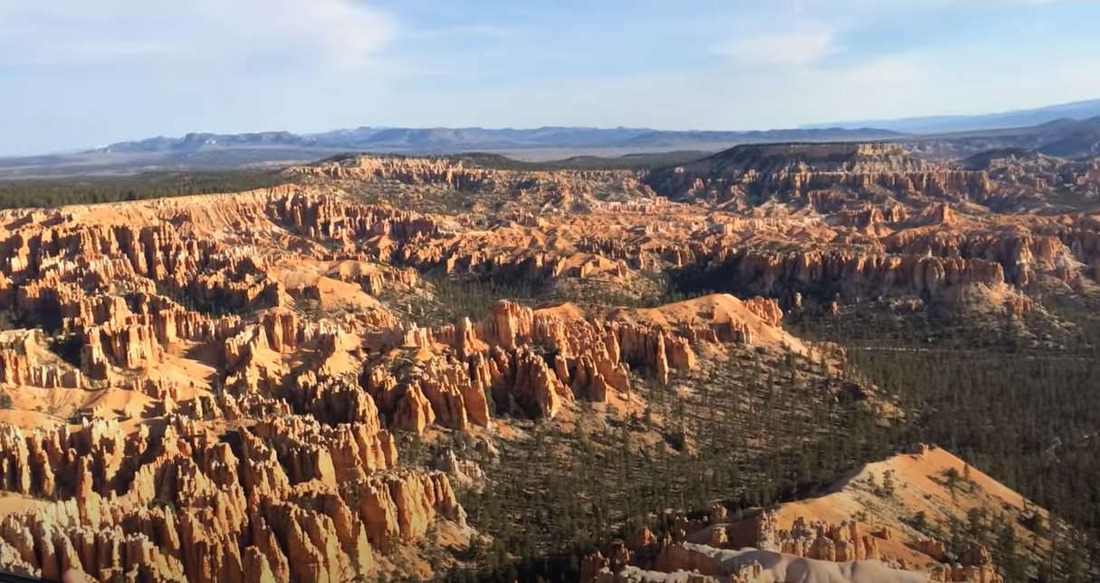
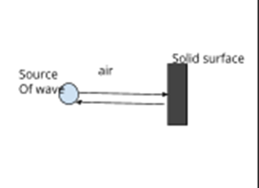
Echo
Investigation of speed change
and reflection of waves
What type of wave are you observing? | What medium did the wave travel through first? | What change in medium did the wave encounter? | How did its behavior change? | Diagram of wave, medium, and changes in wave.
Sound/ mechanical | Air | Rock, a large, solid, rigid surface | It bounced back or reflected
Standard 8.PS4.2

Slide 5
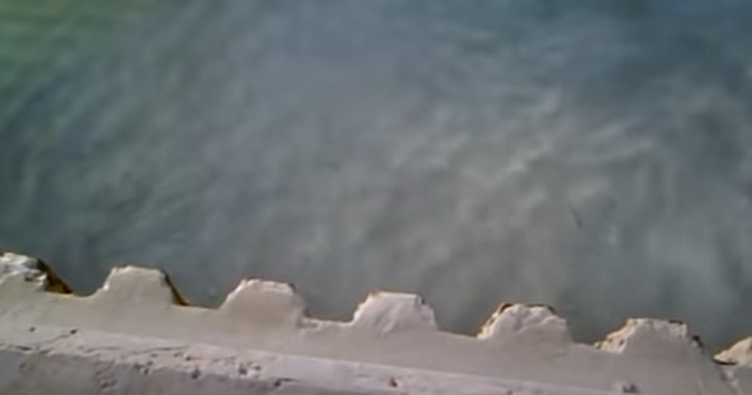
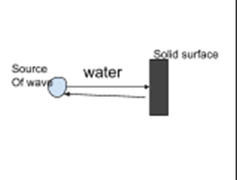
Wave Reflection Notes
What type of wave are you observing? | What medium did the wave travel through first? | What change in medium did the wave encounter? | How did its behavior change? | Diagram of wave, medium, and changes in wave.
Water | Water | Side of pool, deck, a large solid, rigid surface | It bounced back or reflected
Standard 8.PS4.2

Slide 6
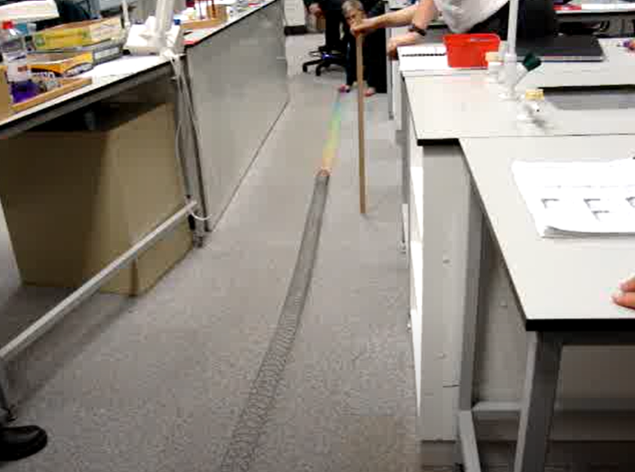
Have you ever heard a sound traveling through a different substance other than air?
What substance was it and in what ways did it change the sound?
With what we have learned about waves, what do you think is causing this change in behavior of the sound waves?
Fill in data table 2
Standard 8.PS4.2

Slide 7
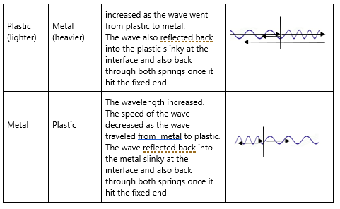
Answer the questions at the bottom of the page of data table 2
Standard 8.PS4.2

Slide 8
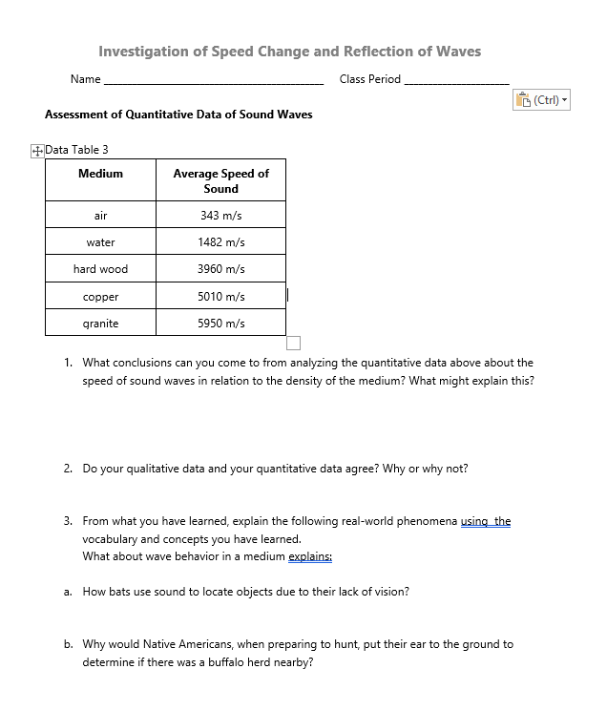
Complete this page on your own and turn it in when you are finished.
Standard 8.PS4.2

Slide 9
Exit ticket
What type of wave needs a medium to travel through?
There is a Legends in Learning assignment in TEAMS that you can work on until 10-26 to help you understand waves.
Standard 8.PS4.2

